Slide 1
isolation , processing of specimen for isolation , isolation in culture , pure culture
Techniques
Dr . Rana A. Fayez

Slide 3
Isolation
Microorganisms occur in huge numbers.
*Isolation of single species (pure culture) is done by :
Streak plate method
Spread plate method
Pour plate method
*Based on diluting sample out to a point where
a single cell will give rise to a single colony

Slide 5
Specimen collection
Many different specimens are sent for microbiological examination from patients with suspected bacterial infection.
Common specimens include urine, faeces, wound swabs, throat swabs, vaginal swabs, sputum, and blood.
cerebrospinal fluid, pleural fluid, joint aspirates, tissue, bone and prosthetic material (e.g. line tips).

Slide 8
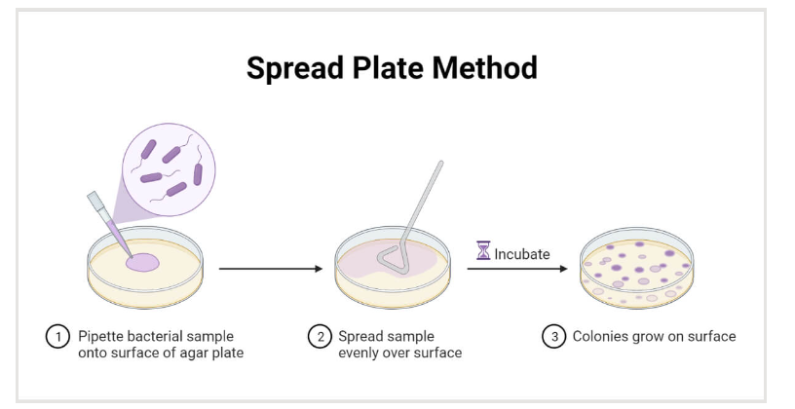

Slide 9
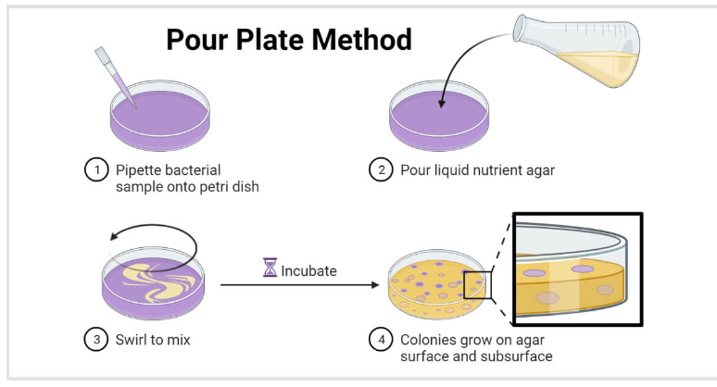

Slide 11
What are dilutions in microbiology?
Dilution is the process of making a solution weaker or less concentrated.
In microbiology, serial dilutions (log dilutions) are used to decrease a bacterial concentration to a required concentration for a specific test method, or to a concentration which is easier to count when plated to an agar plate

Slide 13
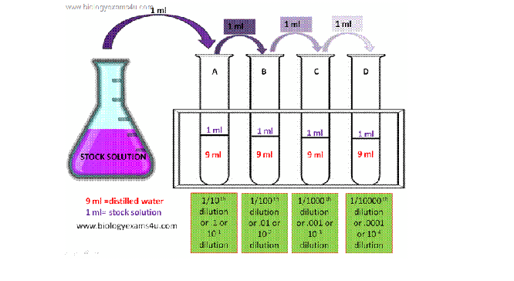
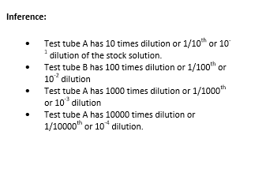

Slide 14
